Slide 1
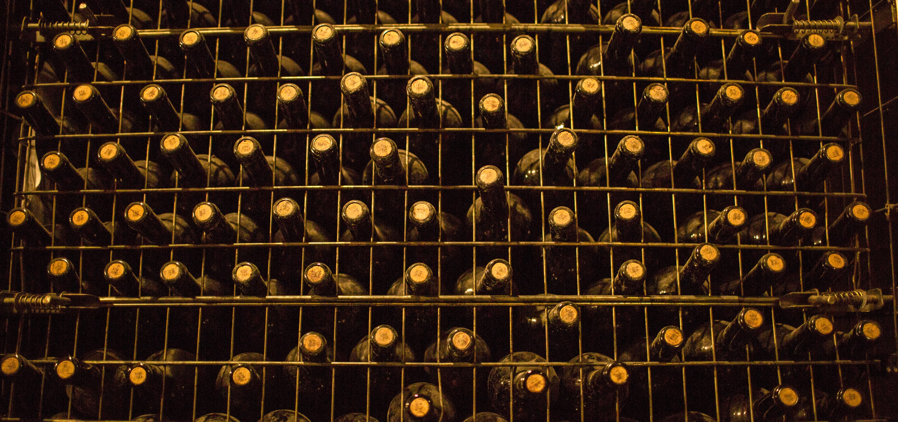
Modeling Capabilities of Digital Twin Platforms – Old Wine in New Bottles?
ECMFA@STAF ‘22
Jérôme Pfeiffer¹,
Daniel Lehner²,
Andreas Wortmann¹,
Manuel Wimmer²
1 Institute for Control Engineering of Machine Tools and Manufacturing Units, University of Stuttgart, Germany
2 CDL-MINT, Institute for Business Informatics - Software Engineering, Johannes Kepler University Linz, Austria
Photo by Kelsen Fernandes on Unsplash
Notes:
Hello everybody, and welcome to my talk at ECMFA 22
Name
research assistant at university of Stuttgart
Present the joint paper of my co-authors, Daniel Lehner, Manuel Wimmer from JKU Linz, and Andreas Wortmann and me from ISW of the university of Stuttgart.
Paper Title
Want to shed light into the modeling capabilities of digital twin platforms. Do they use completely new modeling concepts or are they rather old concepts based on existing modeling standards

Slide 2


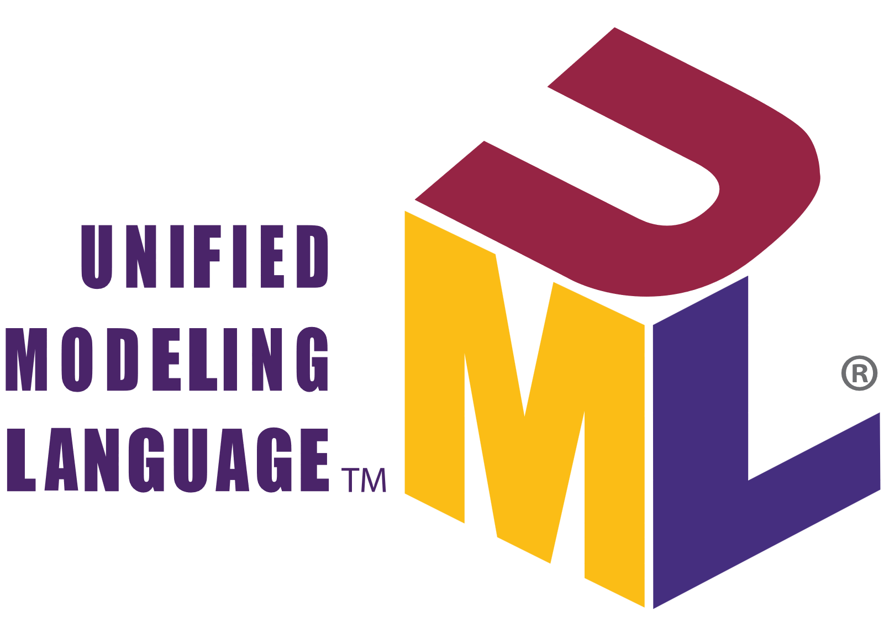

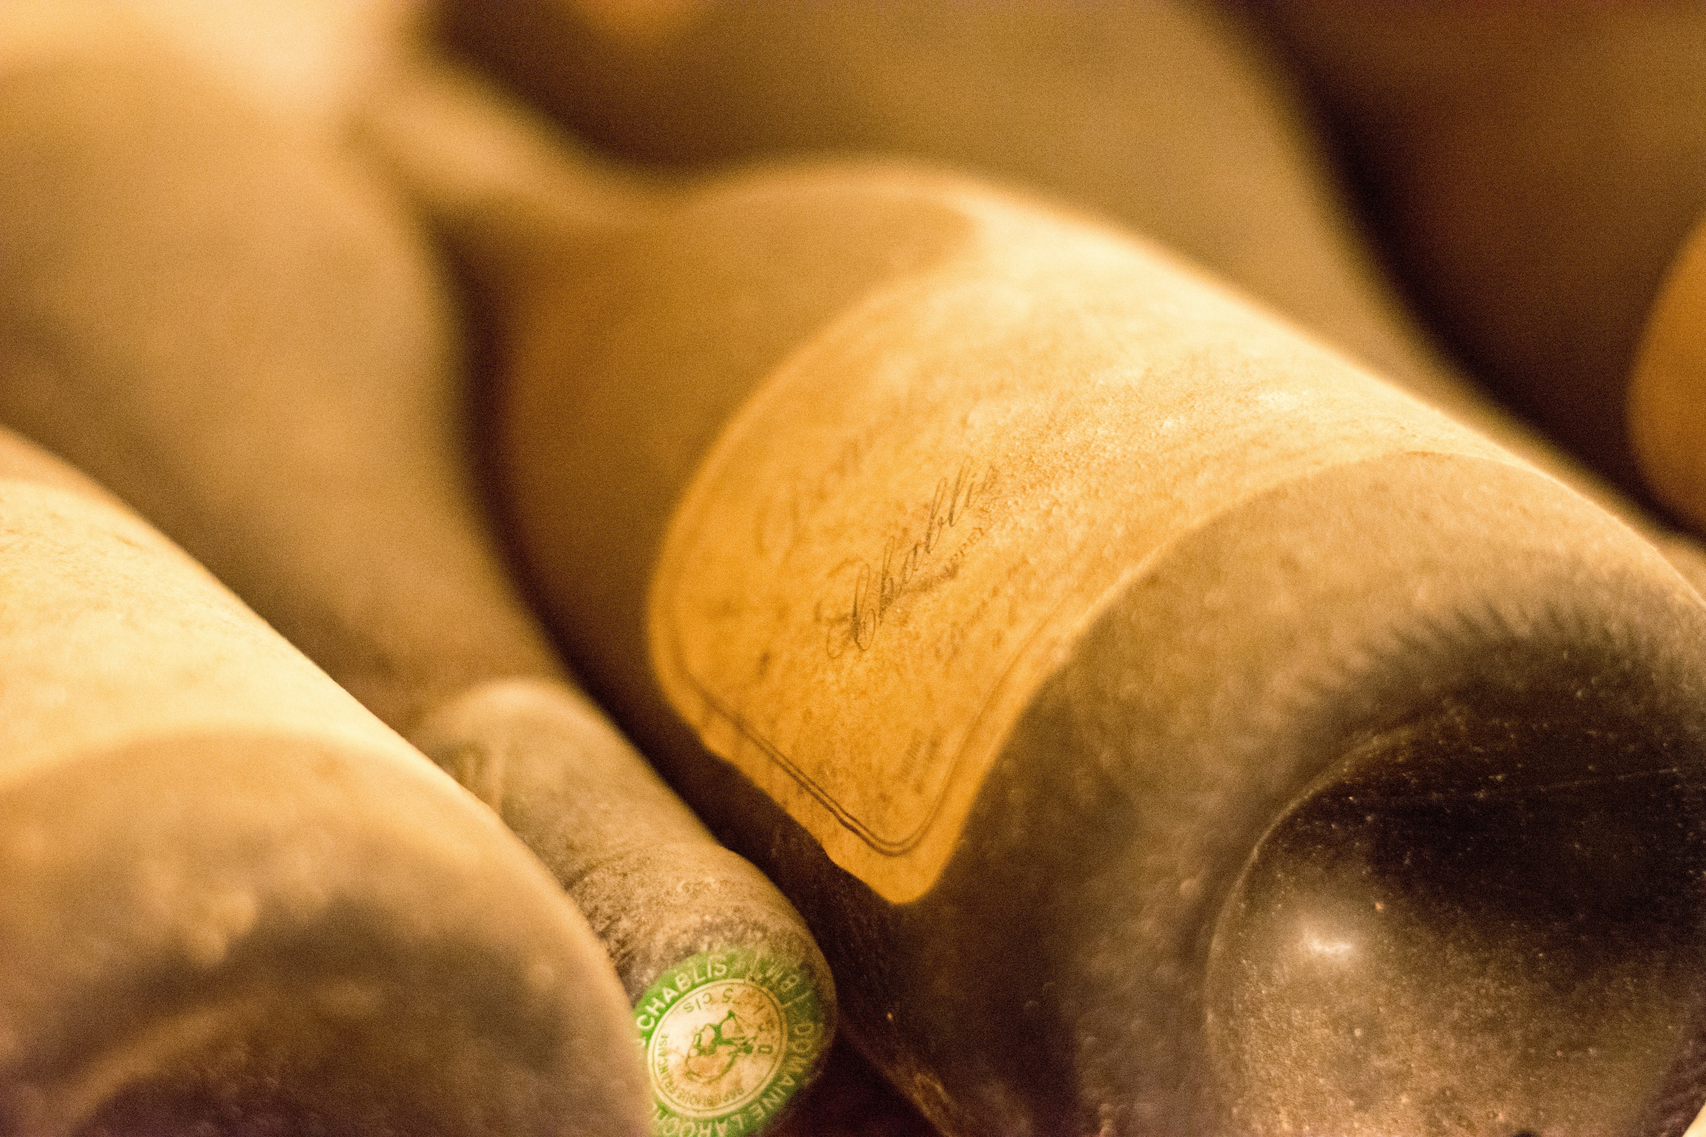

Motivation
Digital Twins (DTs) monitor and optimize cyber-physical systems
Developing DTs requires collaboration between software experts and CPS experts
DT Platforms provide dedicated modeling languages to facilitate DT engineering
New concepts? Or existing concepts (old wine) wrapped in new textual syntaxes (new bottles)?
Old wine in new bottles?
Photo by Marco Mornati on Unsplash
Photo by Dan Cristian Pădureț on Unsplash
Notes:
Let’s start with the motivation of our research
Digital Twins (DTs) monitor and optimize cyber-physical systems (CPS)
Developing DTs requires collaboration between software experts and CPS experts which opens this famous conceptual gap between problem domain and solution domain
Modeling languages try to bridge the gap between CPS (domain) experts and software engineering experts
Thus, DT platforms provide dedicated modeling languages
We investigated three so called digital twin platforms and their provided modelling capabilities and analyzed whether they provide completely new modelling techniques or rather existing and known techniques (old wine) but wrapped into these new shining platforms (new bottles)
Digital Twin Platforms: MS Azure Digital Twins, AWS IoT TwinMaker, Eclipse Vorto

Slide 3
RQ1: What are the conceptual metamodels used by existing DT platforms? RQ2: How do they relate to existing modeling concepts and standards? RQ3: How can existing modeling concepts enable portability?
Research Questions
Notes:
This led us to the following research questions
Before we answer these questions let’s first take a look at the platforms that we investigated
For each: we will show their definition of the digital twin, and a example model of their modeling language

Slide 4

Microsoft Azure Digital Twin
A digital model of real-world things
Definition: A digital twin is a digital model of real-world things, places, business processes, and people
JSON-based Digital Twin Definition Language (DTDL)
Models
Contextualize raw data
Act as contract to other services
Queries for analysis on received data
Visualization
DTDL
1
2
3
4
5
6
7
8
9
10
11
12
13
14
15
16
17
18
19
{
"@id": "dtmi:com:example:Building;1",
"@type": "Interface",
"displayName": "Building",
"contents": [
{
"@type": "Property",
"name": "name",
"schema": "string",
"writable": true
},
{
"@type": "Relationship",
"name": "contains",
"target": "dtmi:com:example:Room;1"
}
],
"@context": "dtmi:dtdl:context;2"
}
https://azure.microsoft.com/en-us/services/digital-twins/
Notes:
Let’s start with the first digital twin platform: MS Azure Digital twin
Querying of data from Azure’s cloud and external services to perform analysis and computation on received data

Slide 5
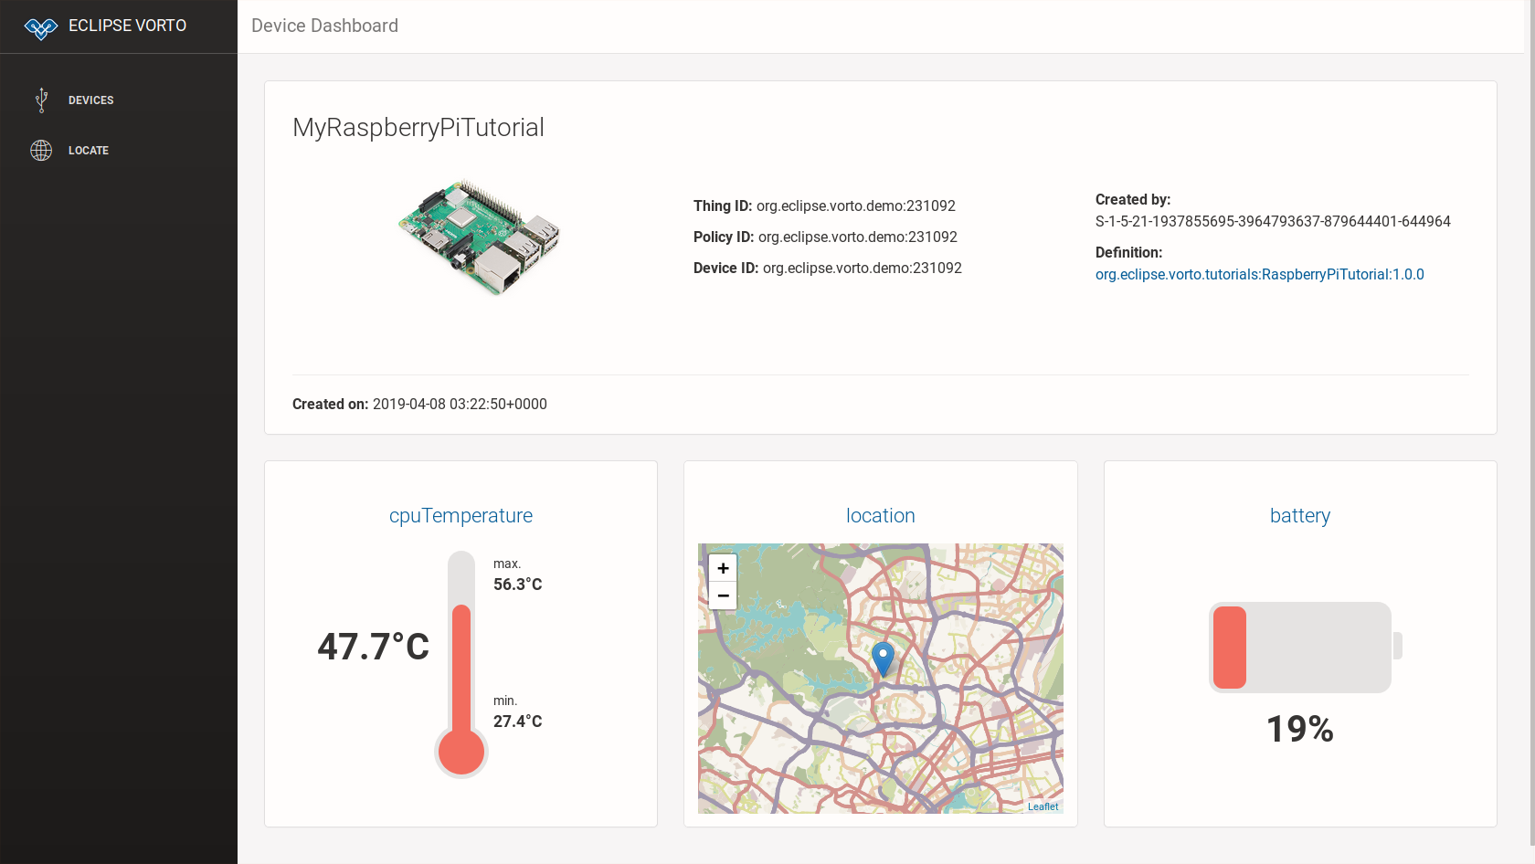

Eclipse Foundation
Digital Twins mirror the physical world
Definition: A digital twin
mirrors physical assets/devices
provides various aspects + services around devices
keeps real and digital world in sync
Modeling language: VortoLang (VL)
Code generators translate models into applications
VL
1
2
3
4
5
6
infomodel ECar{
functionblock {
battery as Battery
//…
}
}
1
2
3
4
5
6
functionblock Battery {
status {
mandatory remainingCapacity as Percentage }
}
https://github.com/eclipse/vorto/blob/master/docs/tutorials/create_webapp_dashboard.md
https://www.eclipse.org/vorto/

Slide 6
AWS IoT TwinMaker
A dynamically updated digital representation of data
Definition:
A digital twin is a live digital representation
Dynamically updated with data to mimic the structure of the system
IoT TwinMaker is an AWS service
API to create digital twin models via JSON
Digital twin consist of components representing structural elements of the digital twin
Enables querying and visualization
AWS
1
2
3
4
5
6
7
8
9
10
11
12
13
14
15
16
17
{
"componentTypeId": "example.alarm",
"workspaceId": "MyWorkspace",
"isSingleton": false,
"propertyDefinitions": {
"alarm_status": {
"dataType": {
"type": "STRING"
"allowedValues": [
{
"stringValue": "ACTIVE"
},//...
],
}, //...
}
}
}
https://docs.aws.amazon.com/iot-twinmaker/latest/guide/twinmaker-component-types-examples.html

Slide 7
RQ1: What are the conceptual metamodels used by existing DT platforms?
Notes:
After we introduced the three platforms and their definition of a digital twin we now want to answer RQ1
To enable structured comparison of the DT languages provided by platforms we derive the conceptual metamodels
We did not take the concrete syntax into account since we aim for a pure conceptual comparison based on metamodels
We already got a glimpse on concrete syntax with the example models before
So: in the following: presentation of simplified metamodels of the languages provided by the platforms
→ full metamodel with all attributes, cardinalities etc. is depicted in paper

Slide 8
RQ1: What are the conceptual metamodels used by existing DT platforms?
Uncovering the metamodel of Microsoft Azure DTDL
Extracted metamodel from GitHub¹
Structural description via
Interface: type of physical asset
Command: interaction with devices
Telemetry: continuous data streams
Property: not frequently changing
Relationship: association to interfaces
Component: composition of interfaces
DTMI
1
0..2 extends
Interface
DTElement
1 target
InterfaceContent
Command
Telemetry
Property
*
Relationship
Component
1
1
Schema
Object
Map
GeospacialSchema
InterfaceSchema
Array
Enum
PrimitiveSchema
¹https://github.com/Azure/opendigitaltwins-dtdl/blob/master/DTDL/v2/dtdlv2.md

Slide 9
RQ1: What are the conceptual metamodels used by existing DT platforms?
Uncovering the metamodel of Eclipse VortoLang
Based on Ecore metamodel²
Describe asset structure via:
InformationModel: aggregates FunctionBlocks
FunctionBlock: reusable implementation parts
Event: a list of properties with timestamp
Operation: interaction with described asset
Property: attribute of function block
InformationModel
*
FunctionBlockProperty
superType
0..1
0..1 type
FunctionBlockModel
FunctionBlock
0..1 extended FunctionBlock
*
*
status *
* fault
* config
Event
Operation
Property
*
²https://github.com/eclipse/vorto/tree/development/core-bundles/meta-model.
Notes:
FunctionBlock: reusable implementation part that contain events, operations, or properties

Slide 10
RQ1: What are the conceptual metamodels used by existing DT platforms?
Uncovering the metamodel of AWS IoT TwinMaker
Extracted metamodel from API description³
Model data received from devices
ComponentType: defines a type of assets
Function: reference a function for interaction
PropertyDefinition: Defines properties
DataType: type of properties
Relationship: associations between types
[0..10] extendsFrom
ComponentType
*
Function
0..1 target
*
required Properties
nestedType
Property Definition
*
1
DataType
0..1
0..1
Relationship
³ https://docs.aws.amazon.com/iot-twinmaker/latest/guide/what-is-twinmaker.html
Notes:
Function: reference a function for interaction with the described assets
PropertyDefinition: Defines properties, i.e., attributes of the component

Slide 11
RQ1: What are the conceptual metamodels used by existing DT platforms?
Summary
Metamodels employ similar concepts for structural modelling, e.g., type and property definition
All metamodels support versioning of modeling concepts
Difficulties: Inprecise or missing descriptions: e.g., faults in Eclipse Vorto
Interesting restrictions:
Different upper bounds for inheritance from super-classes
Different inheritance depth limitations
Neither discussed nor rationals provided in platform documentation
Notes:
Function: reference a function for interaction with the described assets
PropertyDefinition: Defines properties, i.e., attributes of the component

Slide 12
RQ2: How do the concepts of platform languages relate to existing modeling concepts and standards?
Notes:
Given that all three investigated platforms pursue to describe data structures we now want compare these concepts to existing modeling techniques
→ To answer RQ2: .. .

Slide 13
RQ2: How do they relate to existing modeling concepts and standards?
Summary: A comparison with concepts of object-orientation
OOM Concepts (UML CD) | DTDL Metamodel | Vortolang Metamodel | TwinMaker Metamodel
Class | Interface | FunctionBlock | ComponentType
Property | Property | Property | PropertyDefinition (isTimeSeries=true)
Temporal Property | Telemetry | Event | PropertyDefinition (isTimeSeries=false)
Association | Relationship | - | PropertyDefinition. DataType. Relationship
Method | Command | Operation | Function
Composition | Component | Function BlockProperty | -
Notes:
High-level comparison shows most modeling concepts can also be found in common OOM like UML CD
Vortolang has only composition, but no associations between function blocks
AWS has no composition, just relationships
In UML CD Time-series properties only possible via extension
In the paper, we performed a detailed comparison of all these concepts and there metaclass attributes.
Many are covered too by UML CD
But some concepts are restricted in the platform metamodels: e.g., cardinality of inheritance.
Types of properties are often limited to common types found in OO like primitive data types, String, Collections, Map etc.
From IoT Background of platforms: Measurement Units for properties
AWS and Azure: Reference to other platform services (implementedBy in AWS Function)
Constraining values is possible via OCL or enums/sets of allowed values

Slide 14
RQ3: How can existing modeling concepts enable portability?
Notes:
Discovered: most concepts found in platforms are available in UML CD
Therefore: RQ3
With portability, we could model the data structures platform independent in UML and then transform to platform-specific models

Slide 15
RQ3: How can existing modeling concepts enable portability?
Using UML CD as a pivot language for portability between platforms
Using UML CD as a pivot
UML CD profile for digital twins (DTUML)
Stereotypes for platform-specific concepts
Add stereotypes to all CD metaclasses
Transform between DT languages
Reduce transformations from n•(n-1) to 2•n
Profile DTUML
«Stereotype»
DTUML_Property
«Metaclass»
Property
trafo
trafo
trafo
«metamodel»
DTDL
«metamodel»
TwinMaker
«metamodel»
VortoLang
Notes:
We use CD as a pivot
From there we add a UML profile to the UML CD metamodel with
Stereotypes for the platform specificas and assign them to the corresponding metaclasses
Transform between platforms
realized with ATL on Ecore metamodels
Platform-specific translation into concrete platform models

Slide 16
RQ3: How can existing modeling concepts enable portability?
Extending UML CD to a digital twin variant of UML CD (DTUML)
Differentiate between
generic stereotypes for shared concepts
platform-specific stereotypes
Transformation from platform-specific model to DTUML without information loss
Limitations
Information loss between platforms
Default values or derivation rules
Extend Profile for new platforms
Profile DTUML
«Stereotype»
DTProperty
«Metaclass»
Property
Boolean isTimeSeries
String unit
String type
Class type
Int lower
Int upper
Boolean readOnly
Property redefinedProperty
Value defaultValue
«Stereotype»
VL_Property
«Stereotype»
DTDL_Property
«Stereotype»
TM_Property
Boolean isFault
String constraintRule
String quantity
Boolean isExternalId
Boolean isStoredLocally
List<String> allowedValues
Notes:
Let’s take a look at a concrete profile of DTUML for properties
All elements are extended with
displayName (DTDL)
identifier (DTDL)
description (DTDL, Vortolang)

Slide 17
RQ3: How can existing modeling concepts enable portability?
Applying the DTUML Profile to a demonstration case (for DTDL and TM)
«TMClass»
{isSingleton = true} Building
*
Robot
«DTDLClass» {displayName = „Temperature Sensor“} TemperatureSensor
*
String type
String value «DTProperty» {
isTimeSeries = true
unit = „degreeFahrenheit“}, «DTDLProperty»{
quantity = „Temperature“}
*
1
Room
*
Controller
int aqLevel «DTProperty» { isTimeSeries = true }
1
«DTDLClass»
{displayName = „ CO₂ Sensor“}
CO2Sensor
Alarm
*
*
Boolean isActive
String type
String value «DTProperty» {
isTimeSeries = true
unit = „ppm“ }
«DTDLClass»
{displayName = „Ventilation System“}
VentilationSystem
Notes:
Next we take a look at a concrete class diagram annotated with stereotypes of our profile DTUML
The CD represents a scenario where:
Robots equipped with controller and attached temperature and CO2 sensor drives around rooms and can give an alert whenever a certain threshold is passed.
Rooms can then activate their ventilation system to improve air quality
Transforming from a DTDL -> DTUML -> TM
But: loose of information that is specific to platforms and not applicable
isSingleton not applicable in DTDL
DTDL quantity or displayName are not applicable to TM

Slide 18
Old wine in new bottles?
Notes:
So, finally we can answer the question: are these modeling capabilities of the DT platforms just New or just “Old wine in new bottles?”

Slide 19
Summary
Old Wine in New Bottles?
RQ1: The extracted metamodels share similar modeling concepts
But: Many aspects not covered by platform languages, e.g., communication, performance (MARTE)
RQ2:
Concepts of the platforms align with object-oriented concepts and UML CD
Extend them with domain-specific concepts, e.g., units, time-series
RQ3: Using UML CD as a pivot, together with an UML profile enables portability (with limitations)
Outlook:
Explore other DT platforms and derive a pivot DT DSL for their platform independent description
Design a language family (product line) for describing further aspects of digital twins
Notes:
Unfortunately, and as you all might know now: the answer is yes, they are just pured old wine in new bottles
But lets take a look at the answers to our research questions again:
RQ1:
More specific they wrap CD-like data structure description languages into a modern UI and label them as DT DSLs
Outlook:
Modeling and Analysis of Real Time Embedded Systems (MARTE)
language family including code generation specific to DT platforms

Slide 20
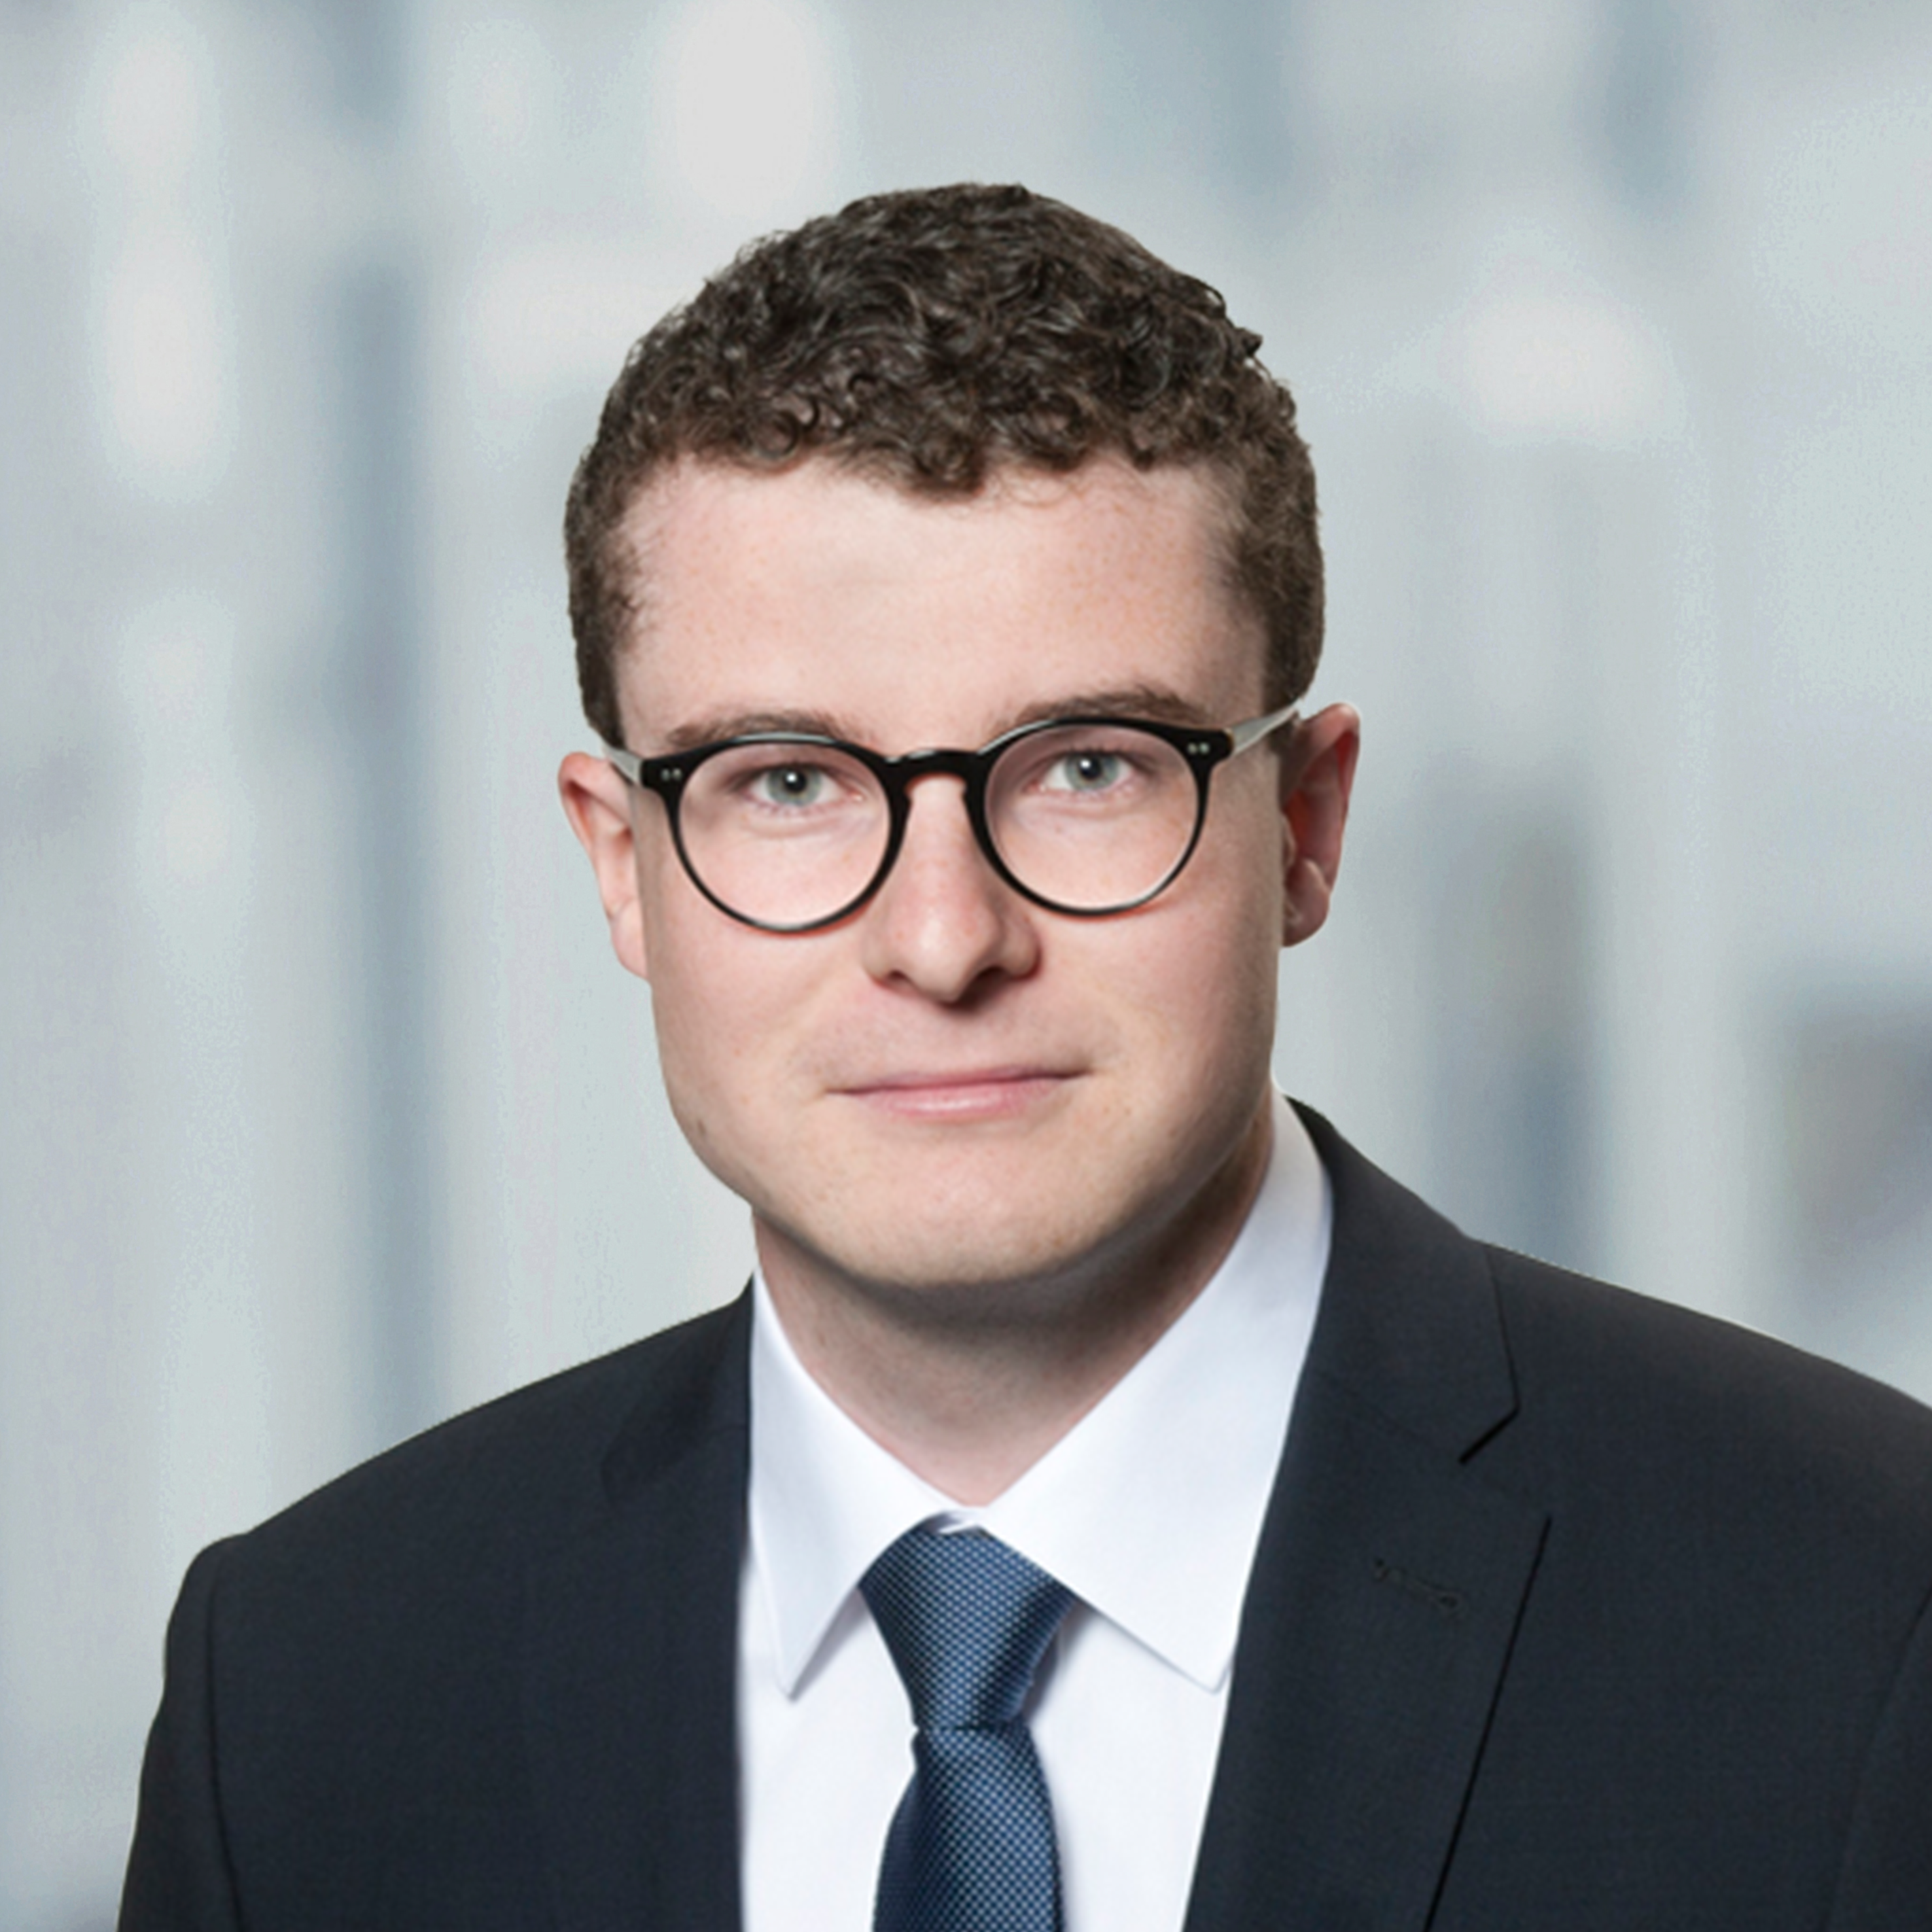

Jérôme Pfeiffer
Research Assistant
jerome.pfeiffer@isw.uni-stuttgart.de
94500
linkedin.com/in/jerome-pfeiffer/
scan for full paper
Notes:
Thank you all for your attention
Now open to any questions you have

